Slide 1
DEEPFAKE DETECTION USING DEEP LEARNING
GUIDE NAME : GURUNATHAN M
DR.L.SAIRAMESH ROLL NO : 2019202015
MCA(REGULAR)

Slide 2
MOTIVATION & OBJECTIVES
Deepfakes are videos altered to look other than their original state with the help of Deep Learning.
These Videos are the primary source of false media controversies, propagate misleading news, fake political videos.
The goal of this project is to create a deep learning model with ResNext50 and LSTM to recognize deepfake videos.

Slide 3
INTRODUCTION
Deep Learning is the subfield of Machine Learning
The Concerned algorithms are inspired by the structure and function of brain.
It works with artificial neural networks, which are designed to how humans think and learn.

Slide 4
Dataset Details
Celebrity Balanced dataset contains 50% real and 50% Fake Videos.
Totally 1600 videos present.
https://github.com/yuezunli/celeb-deepfakeforensics

Slide 5
IMPLEMENTATION PLATFORM / FRAMEWORK
PLATFORM
Visual Studio Code
Google Colab
FRAMEWORK
Django

Slide 6
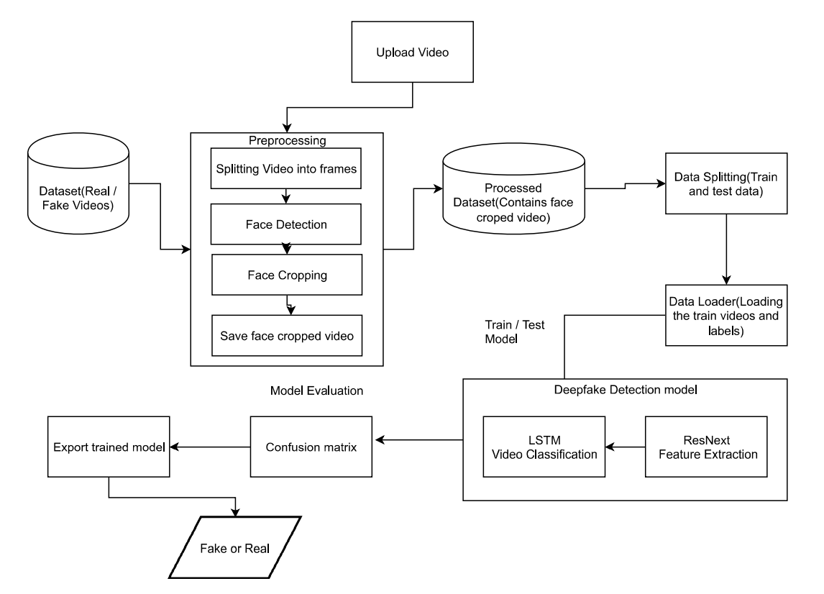
Architecture Diagram:

Slide 7
LIST OF MODULES
Video Preprocessing
Splitting Videos into Frames
Face Detection
Face Cropping
Create Face Cropped Video

Slide 8
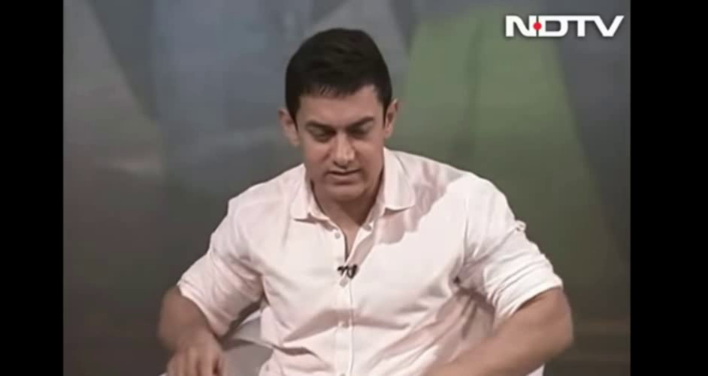
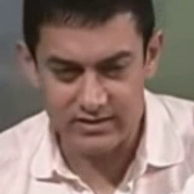
1. Video Preprocessing
Split video into frames
Face Detection
Face Cropping
Input Video
Output Video

Slide 9
1. Video Preprocessing
Using glob we can import all the videos from the directory.
Cv2.VideoCapture is used to read the video.
The video is split into frames and frames are cropped on face location.
The face cropped frames are again written to new video using VideoWriter.
The new video is written at 30 frames per second and with the resolution of 112*112 pixels in the mp4 format.

Slide 10
2. Feature Extraction
Convert the frame images to tensor based on RGB Colour.
ResNext CNN classifier for accurately detecting the frame level features.
Following, we will be fine-tuning the network by adding extra required layers.
The 2048-dimensional feature vectors after the last pooling layers are then used as the sequential LSTM input.

Slide 11
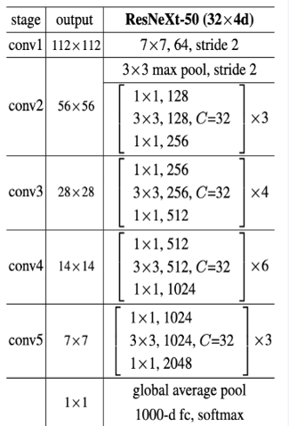
ResNext-50 Architecture
ResNext50 is the Convolutional neural network which is 50 layers deep.
This will take the input image as 112*112 resolution.
Then the image will be processed in all 50 layers.
Output Vector size of the model is 2048.

Slide 12
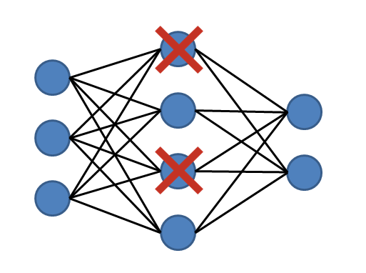
DROPOUT LAYER
Dropout Layer with the value of 0.4 is used to avoid overfitting in the model.
It will deactivate 40% of the neuron in the hidden layer.

Slide 13
3. Sequence Processing
ResNext CNN feature vectors of frames as input for the 2048 LSTM unit, which is capable to do achieve our objective.
LSTM is used to process the frames in a sequential manner
So that the temporal analysis of the video can be made, by comparing the frame at ‘t’ second with the frame of ‘t-n’ seconds.

Slide 14
Feature Extraction & Sequence Processing
Linear layer
Average Pooling layer
Softmax
LSTM
ResNeXt50
Real
Fake
112*112
Image
2048
Units
2048
Units

Slide 15
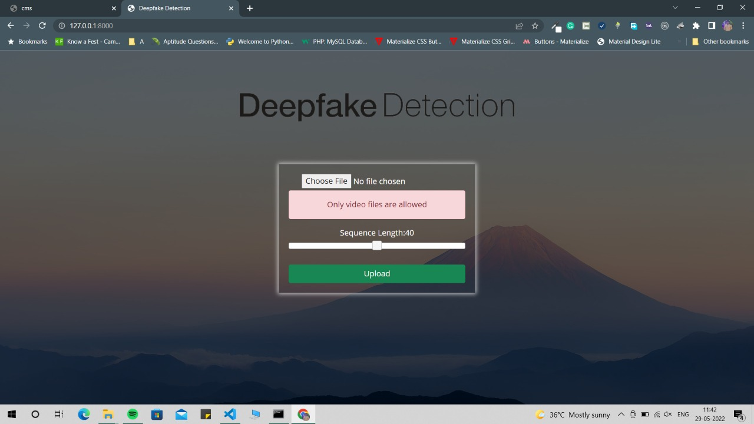
Testcases
Upload a PDF file instead of video
Output :
Only video files are
allowed

Slide 16
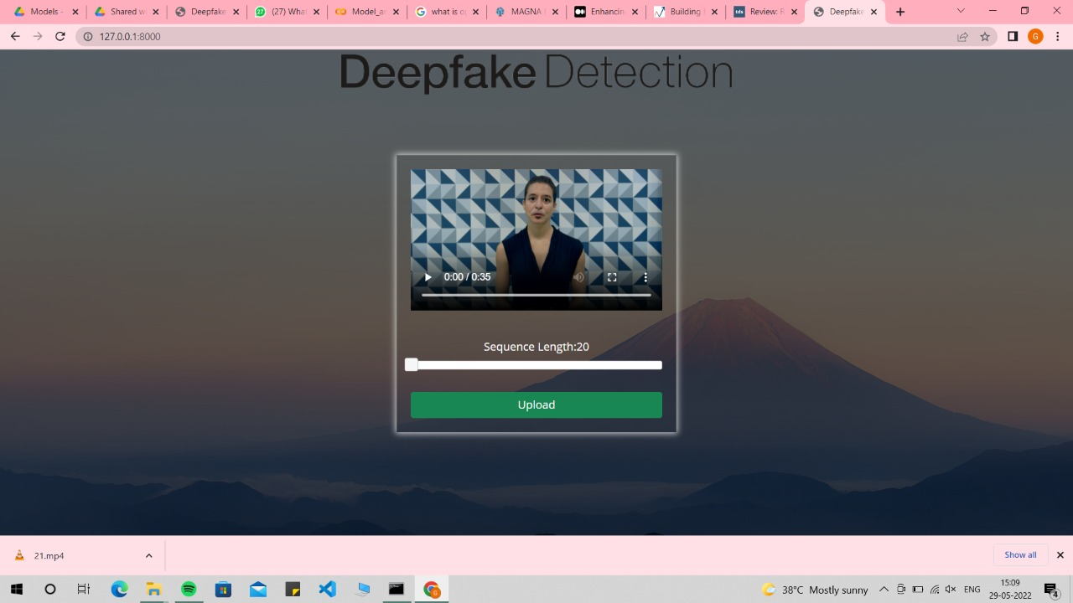
Testcases
2. Upload more than 100 MB Video file

Slide 17
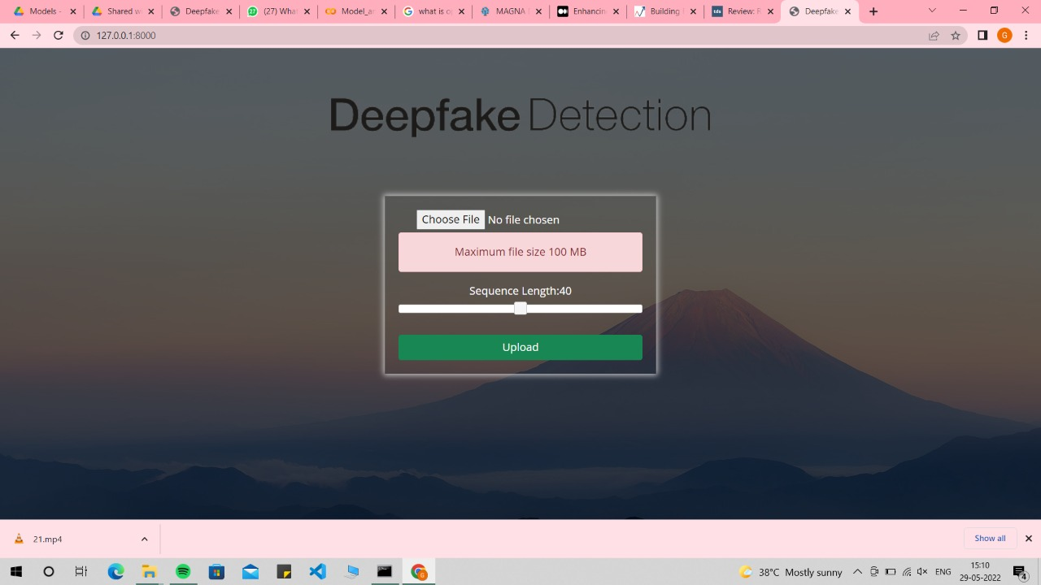
Testcases
2. Upload more than 100 MB Video file
Output :
Maximum file size
is 100 MB

Slide 18
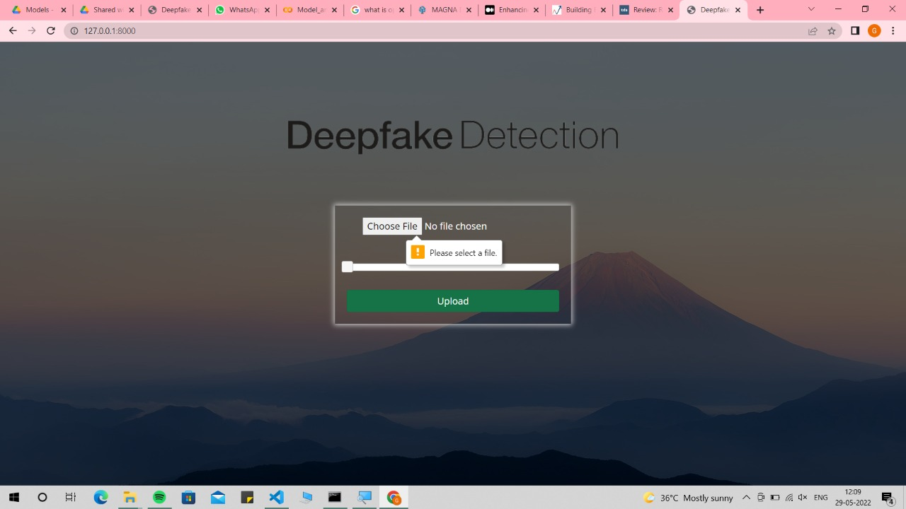
Testcases
3. Press Upload button without selecting video
Output :
Please select a file

Slide 19
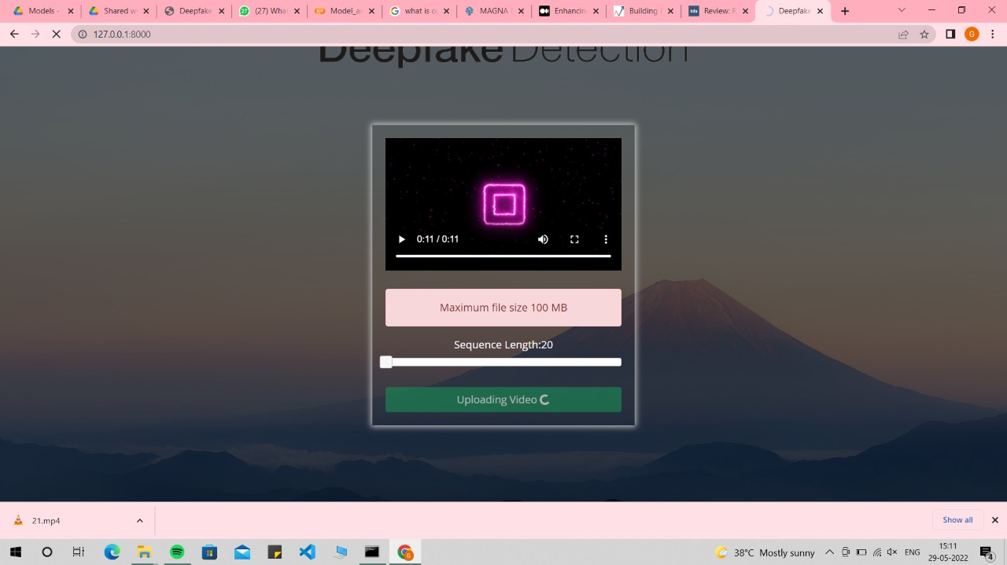
Testcases
4. Upload a file without any faces

Slide 20
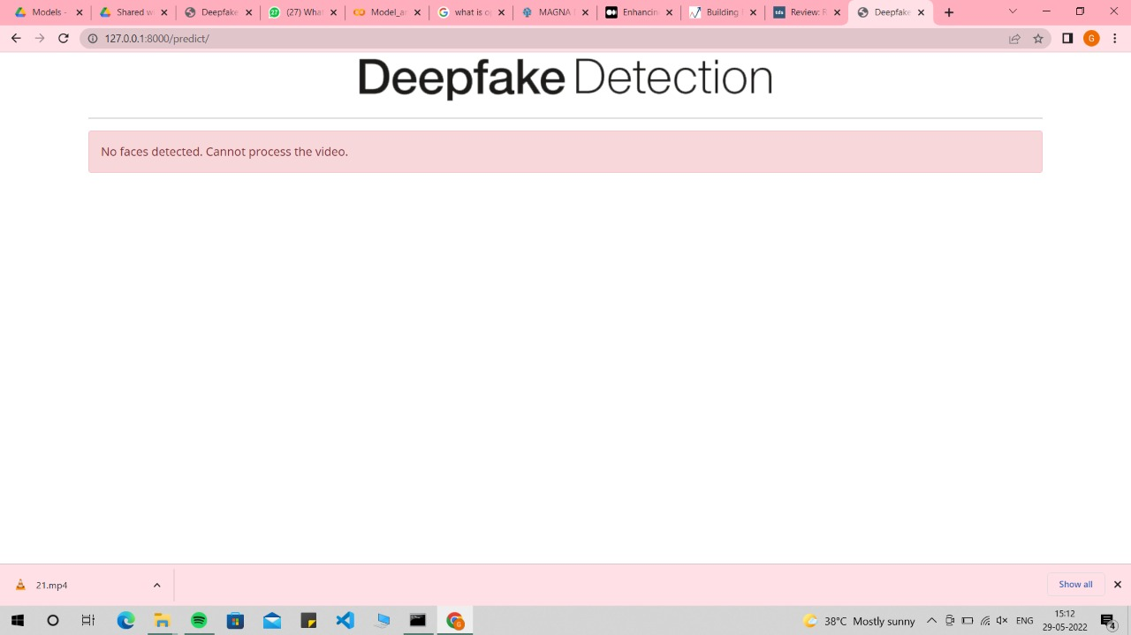
Testcases
4. Upload a file without any faces
Output :
No face detected.

Slide 21
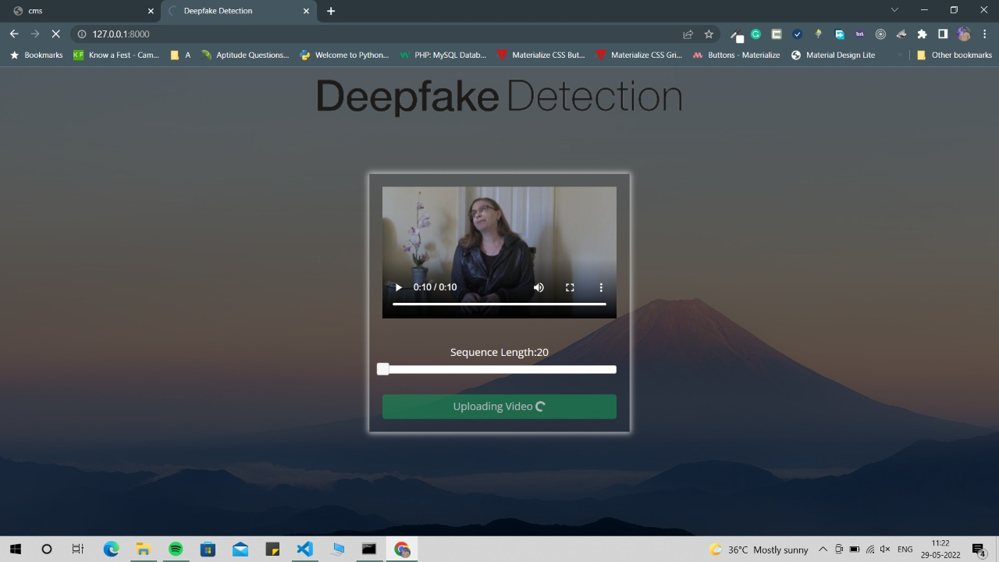
Testcases
5. Upload a Fake Video

Slide 22
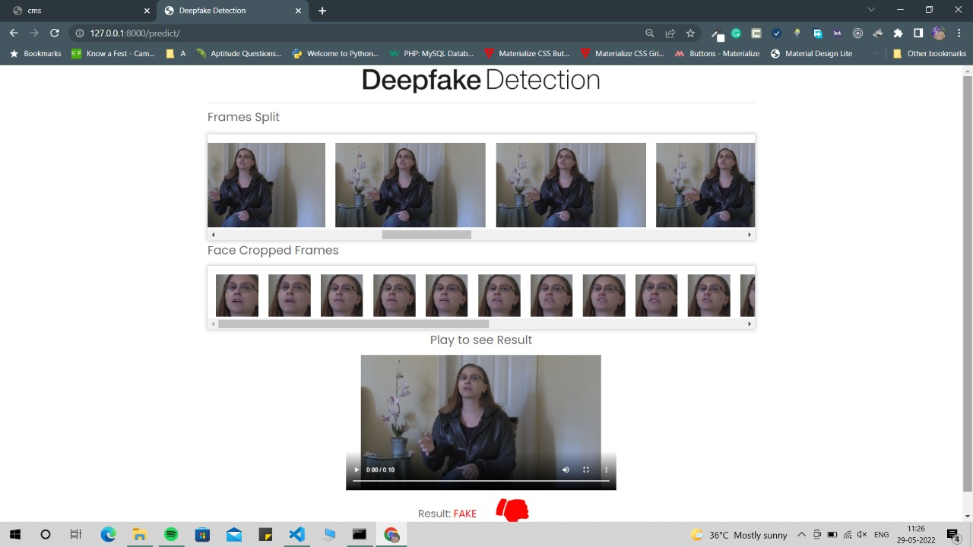
Testcases
5. Upload a Fake Video
Output :
Fake

Slide 23
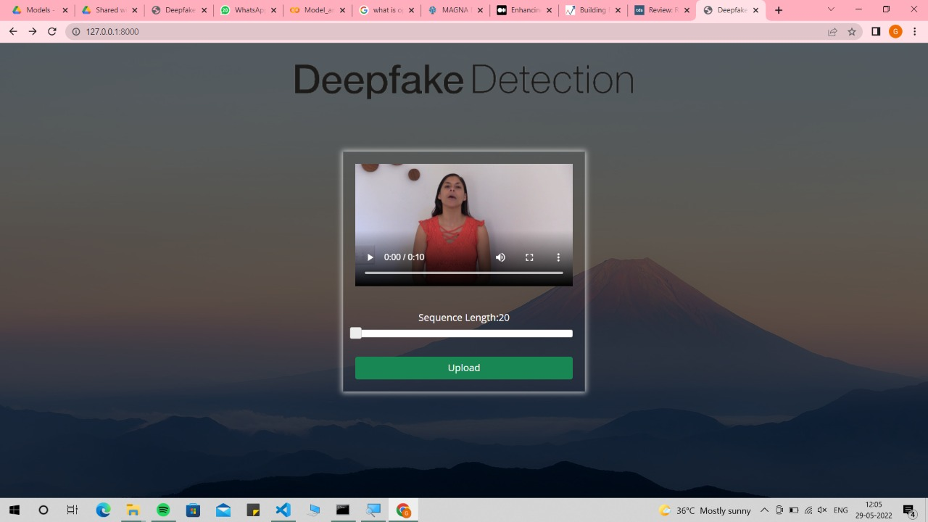
Testcases
6. Upload a Real Video

Slide 24
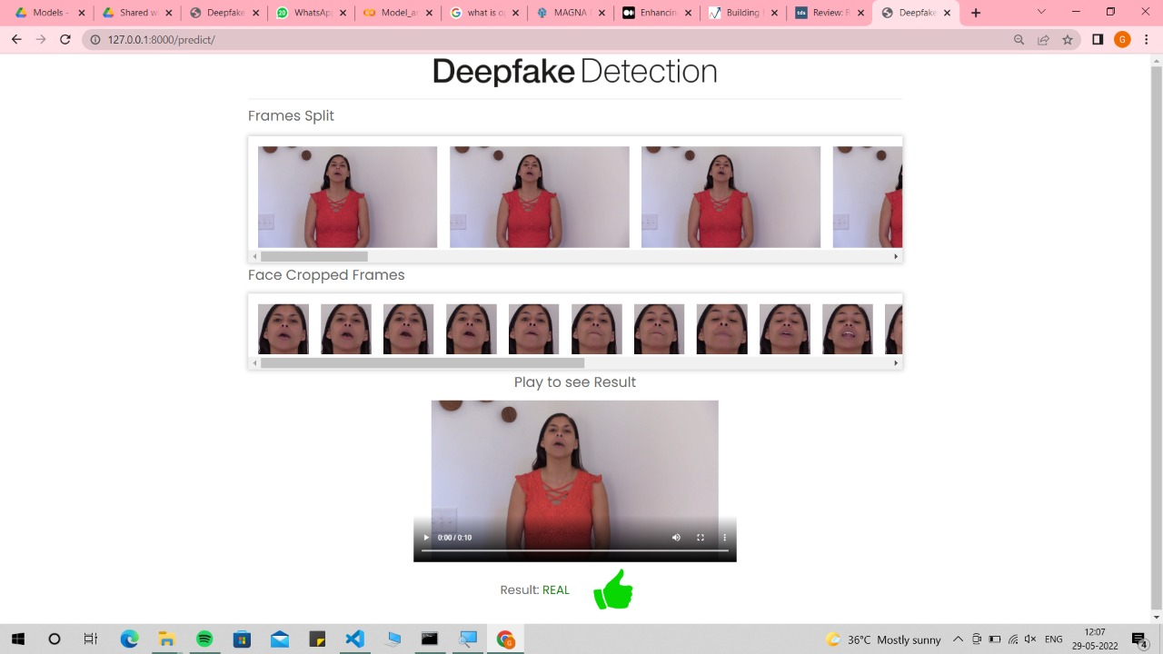
Testcases
6. Upload a Real Video
Output :
Real

Slide 25
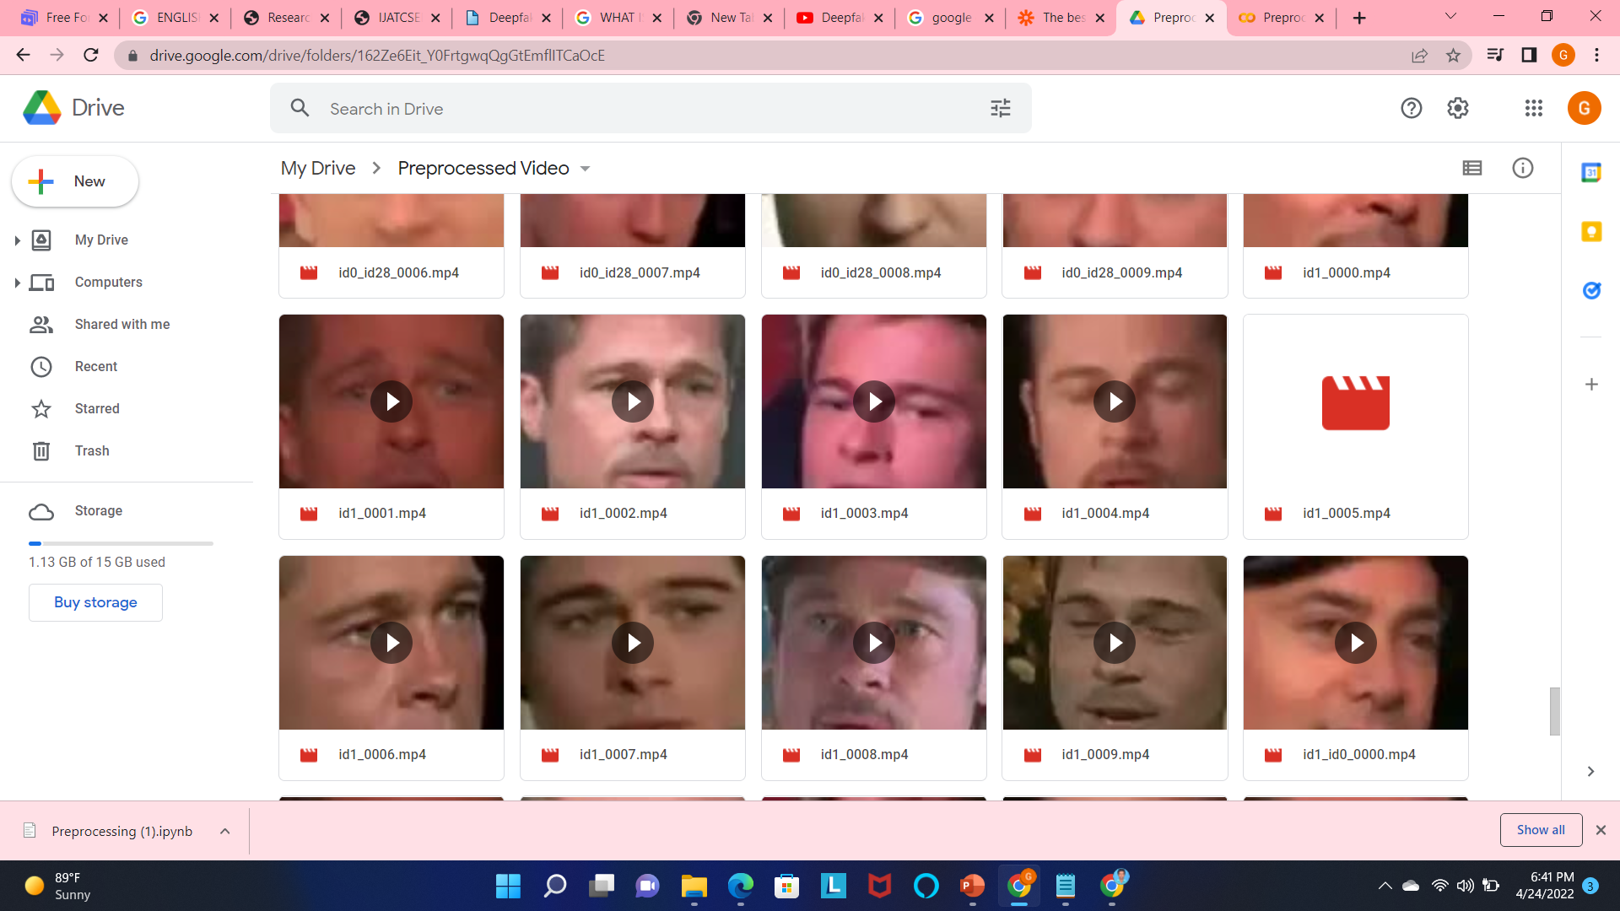
EXPERIMENTAL RESULTS Preprocessing Results

Slide 26
Training and Testing Results
Training Accuracy of 20 frames is 98%.
Testing Accuracy is 94%.
It consumes 4 hours for the training process and Results a checkpoint file.
Model Name | Total Frames | Training Time | Training Loss | Testing loss
ResNext 50 | 20 | 4 Hours | 0.1964 | 0.1554

Slide 27
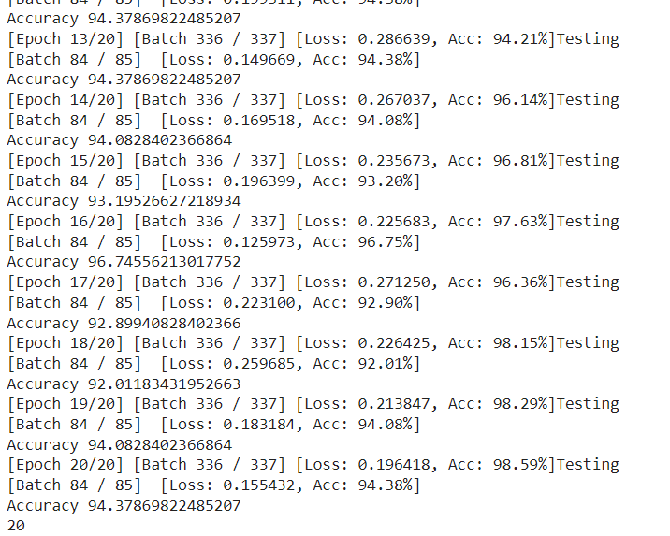
Training and Testing Results

Slide 28
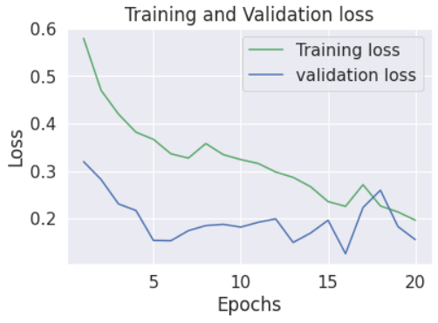
Training and Validation loss

Slide 29
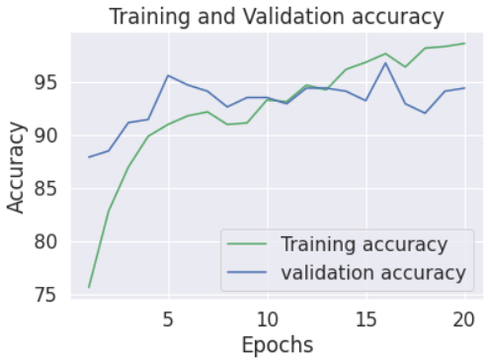
Training and Validation Accuracy

Slide 30
REFERENCES
[1] Yuezun Li, Ming-Ching Chang and Siwei Lyu “Exposing AI
Created Fake Videos by Detecting Eye Blinking” in arxiv.
[2] Aarti Karandikar, Vedita Deshpande, Sanjana Singh, Sayali
Nagbhidkar and Saurabh Agrawal “Deepfake video detection using
Convolutional Neural Network” in IJATCSE, 2020.
[3] EkraamSabir, Jiaxin Cheng, AyushJaiswal, WaelAbdAlmageed,
IacopoMasi, Prem Natarajan , “Recurrent Convolutional Strategies
for Face Manipulation Detection in Videos” in arXiv,2 May 2019.
[4] https://github.com/yuezunli/celeb-deepfakeforensics
[5] https://www.kaggle.com/c/deepfake-detection-challenge/data

Slide 31
THANK YOU

